Slide 1

First and Last Touch Attribution
Learn SQL from Scratch
James Mehisto
November 5th 2018

Slide 2
Table of Contents
Getting Familiar With CoolTShirts
1.1 how many sources? 1.2 how many campaigns? 1.3 what pages are on CoolTShirts?
2. What is the User Journey?
2.1 First touches 2.2 Last touches 2.3 Visitors who purchased 2.4 how many last touches on the purchase page?
3. Optimizing the campaign Budget

Slide 3
1. Get Familiar With CoolTShirts

Slide 4
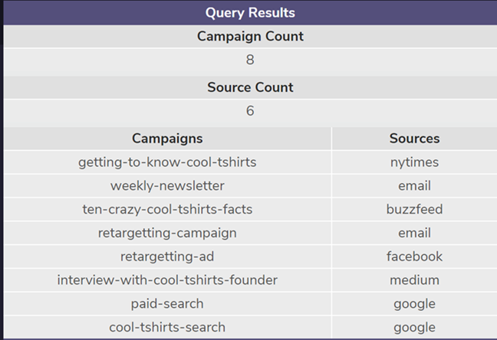
Get Familiar with CoolTShirts
UTM parameters are used by marketers to track the effectiveness of online campaigns across traffic sources and publishing media.
UTM parameters make it easier to view incoming and outgoing traffic through their websites to help decide which campaign or source will help them succeed in the future.

Slide 5
1.1 How Many Sources
As seen below, CoolTShirts uses 6 Sources
A source can be a website page, an email, or an ad on a page that can redirect a customer to the CoolTShirts website.
Utm_source is tracking the type of communication of which source is used by customers.
/* Number of Distint Campaigns */
SELECT
COUNT(DISTINCT utm_campaign) AS 'Campaign Count'
FROM page_visits;
SELECT
COUNT(DISTINCT utm_source) AS 'Source Count'
FROM page_visits;
SELECT
DISTINCT utm_campaign AS 'Campaigns',
utm_source AS 'Sources'
FROM page_visits;

Slide 6
1.2 How Many Campaigns
As seen below, CoolTShirts uses 8 Campaigns
A campaign identifies a specific product promotion that could be used in an ad, a newletter, or a paid search that puts that product at the top of a search.
Utm_campaign is tracking the type of communication of which campaign is shared with customers. Examples can be seen below.
/* Number of Distint Campaigns */
SELECT
COUNT(DISTINCT utm_campaign) AS 'Campaign Count'
FROM page_visits;
SELECT
COUNT(DISTINCT utm_source) AS 'Source Count'
FROM page_visits;
SELECT
DISTINCT utm_campaign AS 'Campaigns',
utm_source AS 'Sources'
FROM page_visits;

Slide 7
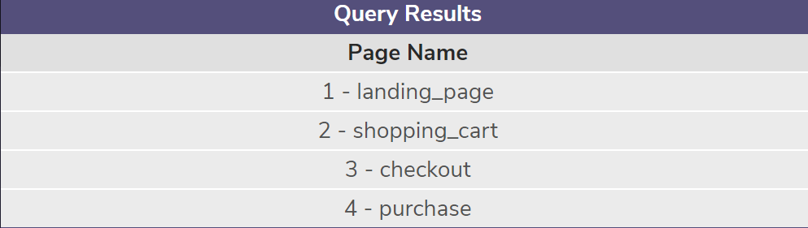
1.3 What Pages are on CoolTShirts?
Below you can see the 4 pages that CoolTShirts is tracking.
/* What Pages ar on CoolTShirts website */
SELECT DISTINCT page_name AS 'Page Name'
FROM page_visits;

Slide 8
2.What is the User Journy?

Slide 9
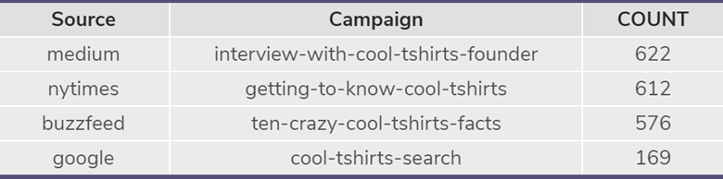
2.1 First Touches
How many first touches is each campaign responsible for?
In the figure below we can see how many First touches each campaign is responsible for.
Visitors most frequently visited cooltshirts.com through interview-with-cool-tshirts-founder campaign with 622 first touches to their website.
/* How many first touches is each campaign responsible for? */
WITH first_touch AS (
SELECT user_id, MIN (timestamp) AS 'first_touch_time'
FROM page_visits
GROUP BY user_id),
ft_count AS (
SELECT ft.user_id,
ft.first_touch_time,
pv.utm_source,
pv.utm_campaign
FROM first_touch AS 'ft'
JOIN page_visits AS 'pv'
ON ft.user_id = pv.user_id
AND ft.first_touch_time = pv.timestamp)
SELECT ft_count.utm_source AS source,
ft_count.utm_campaign AS Campaign,
COUNT (*) AS COUNT
FROM ft_count
GROUP BY 1,2
ORDER BY 3 DESC;

Slide 10
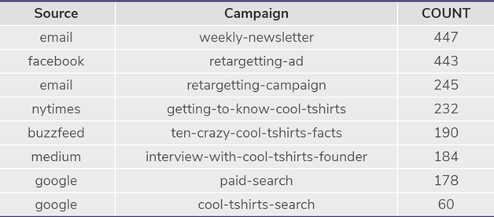
2.2 Last Touches
How many last touches is each campaign responsible for?
In the figure below we can see how many last touches each campaign is responsible for.
Visitors most frequently visited cooltshirts after being reminded by the weekly-newsletter campaign which resulted in 447 last touches to their website.
/* How many last touches is each campaign responsible for? */
WITH last_touch AS (
SELECT user_id,
MAX(timestamp) AS 'last_touch_at'
FROM page_visits
GROUP BY user_id),
lt_attr AS (
SELECT lt.user_id,
lt.last_touch_at,
pv.utm_source,
pv.utm_campaign,
pv.page_name
FROM last_touch lt
JOIN page_visits pv
ON lt.user_id = pv.user_id
AND lt.last_touch_at = pv.timestamp
)
SELECT lt_attr.utm_source,
lt_attr.utm_campaign,
COUNT(*)
FROM lt_attr
GROUP BY 1, 2
ORDER BY 3 DESC;

Slide 11
2.3 Vistors who purchased
How many visitors make a purchase from cooltshirts?
Out of the total number of visitors to cooltshirts.com which is 1979 there are 361 who completed a purchase.
This means that a little over 18% of visitors make a purchase.
/*How many visitors make a purchase? */
SELECT COUNT(DISTINCT user_id) AS 'Visitors who Purchased'
FROM page_visits
WHERE page_name = '4 - purchase';
/* How many total visitors */
SELECT COUNT (DISTINCT user_id) AS 'Visitors in Total'
FROM page_visits;ORDER BY 3 DESC;

Slide 12
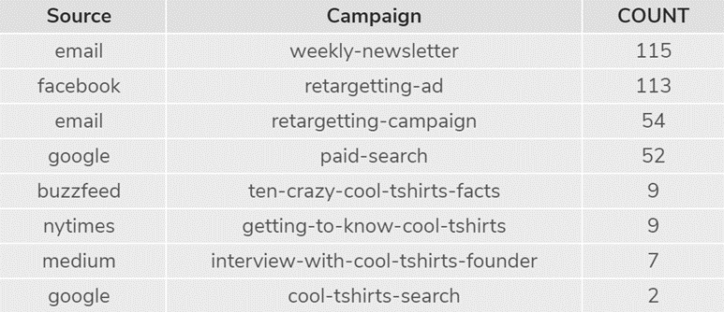
2.4 How many last touches on the purchase page
How many last touches on the purchase page is each campaign responsible for?
By looking at the last touches on the purchase page we can see which campaign was most successful.
Below you can see the weekly-newsletter email was the most successful with 115 last touches.
/*how many last touches on the purchase page is each campaign responsible for? */
WITH last_touch AS (
SELECT user_id,
MAX(timestamp) AS last_touch_at
FROM page_visits
WHERE page_name = '4 - purchase'
GROUP BY user_id),
lt_attr AS (
SELECT lt.user_id,
lt.last_touch_at,
pv.utm_source,
pv.utm_campaign,
pv.page_name
FROM last_touch lt
JOIN page_visits pv
ON lt.user_id = pv.user_id
AND lt.last_touch_at = pv.timestamp
)
SELECT lt_attr.utm_source,
lt_attr.utm_campaign,
COUNT(*)
FROM lt_attr
GROUP BY 1, 2
ORDER BY 3 DESC;

Slide 13
What is the typical user journey?
The journey of a user is based of a series of actions that may or may not result in the purchase of a product.
Although there seems to be clear paths to a purchase such as finding a website, shopping for a product, and purchasing the product, a users journey may take one or more reminders to complete a purchase which can be achieved through various campaigns.

Slide 14
3. Optimizing the Campaign Budget
CoolTShirts is looking to re-invest in 5 campaigns. These choices should be made by a combination of first and last touches that result in a purchase.
The top 3 first touch campaigns are as follows:
Interview-with-cooltshirts-founder with 622 first touches using medium
Getting-to-know-cool-tshirts with 612 first touches using nytimes
Ten-crazy-cool-tshirts-facts with 576 first touches using buzzfeed

Slide 15
3. Optimizing the Campaign Budget Cont..
The top 2 last touch campaigns are as follows:
Weekly-newsletter with 115 last touches using email
Retargeting-ad with 113 last touches using facebook
A combination of the 5 campaigns resulted in the most first and last touch for visitors and have proven to be the most successful for cooltshirts.com.

